Slide 1
Introduction to HTML

Slide 2
What is HTML?
HTML is the standard markup language for creating Web pages.
HTML stands for Hyper Text Markup Language
HTML describes the structure of Web pages using markup
HTML elements are the building blocks of HTML pages
HTML elements are represented by tags
HTML tags label pieces of content such as "heading", "paragraph", "table",...
Browsers do not display the HTML tags, but use them to render the content of the page

Slide 3
An Example
A paragraph is your content
Putting your content into an HTML tag to make it look like a paragraph is structure
<p>This is the content</p>

Slide 4
HTML Elements and Tags
An element is an individual component of HTML
paragraph, image, header,...
an element name indicates its purpose: p for paragraph
A tag marks the beginning and the end of an HTML element
Opening tag and Closing Tag
<tagname>Stuff in the middle</tagname>

Slide 5
TAGS
Tags provide web browsers with instructions about web page i.e. where to display images and how document is structured
Tags are reserved words enclosed between angular brackets(< >)
Tags are comprised of elements and attributes.
An element is an object on a page (such as a heading, paragraph, or image)
attributes are qualities of elements (such as width and height).

Slide 6
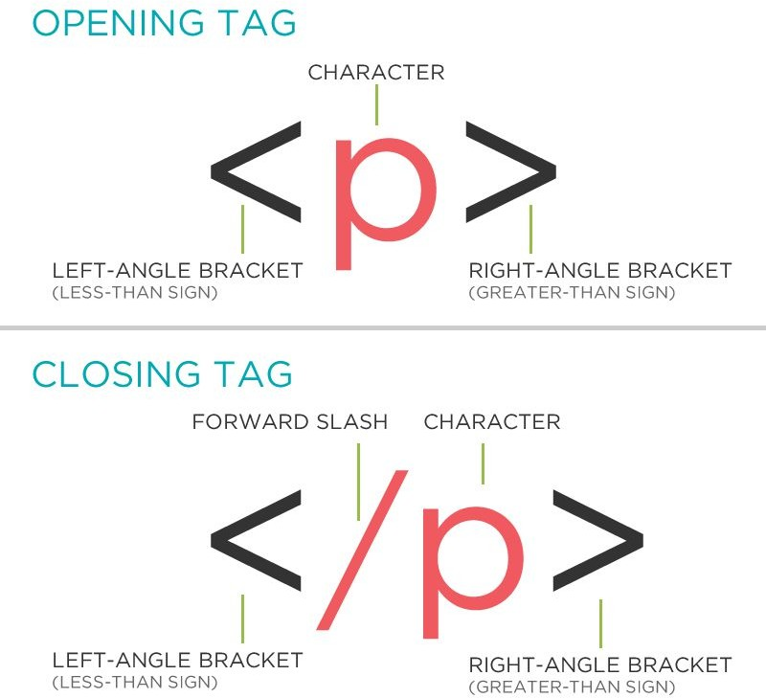
HTML Tag Breakdown

Slide 7
HTML Page Structure
<!DOCTYPE html>
<html>
<head>
</head>
<title>My title</title>
<body>
<h1>My heading</h1>
<p>My paragraph</p>
<img src="my_src"\>My image
</body>
</html>

Slide 8
<!DOCTYPE>
The <!DOCTYPE> declaration represents the document type, and helps browsers to display web pages correctly.
It must only appear once, at the top of the page (before any HTML tags).
The <!DoCtYpE> declaration is not case sensitive.
The <!DOCTYPE> declaration for HTML5 is <!DOCTYPE html>

Slide 9
<html>,<head>,<body>
After <!doctype>, the page content must be contained between <html> tags.
The head contains the title of the page & meta information about the page. Meta information is not visible to the user, but has many purposes, like providing information to search engines.
The body contains the actual content of the page. Everything that is contained in the body is visible to the user. (Some Exceptions!)

Slide 10
Let's create our first HTML page
open a new file in your text editor and copy this code in it:
<!DOCTYPE html>
<html>
<head>
<title>Title of the page </title>
</head>
<body>
The page content here.
</body>
</html>
save the document as myfirstpage.html and open it with a browser.

Slide 11
Anatomy of an HTML element
1. Container Element
An element that can contain other elements or content
A paragraph (<p>content</p>) contains text
2. Stand Alone Element
An element that cannot contain anything else
- <br/>, <img/>

Slide 12
Anatomy of an HTML element
3 Attribute
Provides additional information about the HTML element
Class, ID, language, style, identity, source
Placed inside an opening tag, before the right angle bracket.
4. Value
Value is the value assigned to a given attribute.
Values must be contained inside quotation marks.
<img src="my_picture.jpg" />

Slide 13
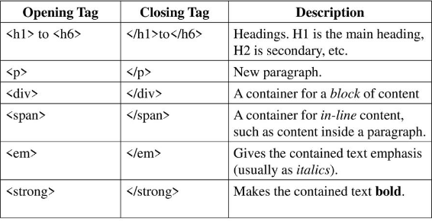
HTML CONTAINER ELEMENTS

Slide 14
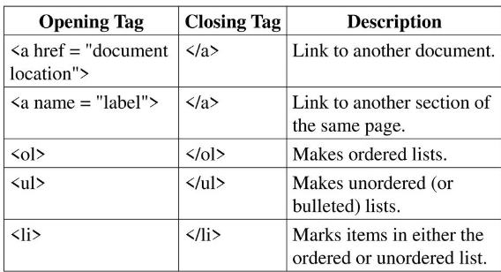
HTML CONTAINER ELEMENTS

Slide 15
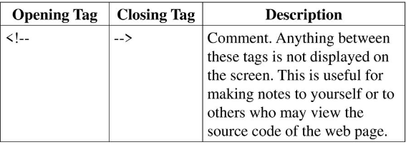
HTML CONTAINER ELEMENTS

Slide 16
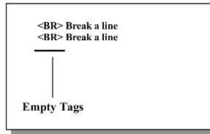
HTML Empty(Non-Container Elements)
These are standalone text which do not contain text. Or any other tag element such as <br/> <hr/>

Slide 17
Html attributes
The lang attribute of the <html> tag declares the language of the Web page
The title attribute defines some extra information about an element
The style attribute is used to add styles to an element, such as color, font, size, and more
The href attribute of <a> specifies the URL of the page the link goes to

Slide 18
Html attributes
The src attribute of <img> specifies the path to the image to be displayed
The width and height attributes of <img> provide size information for images
The alt attribute of <img> provides an alternate text for an image

Slide 19
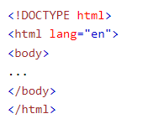
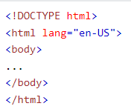
Lang attribute
It is used inside the html tag to declare language of web page
It is meant to assist search engines and browsers

Slide 20
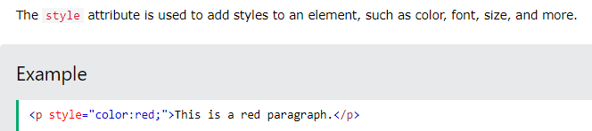
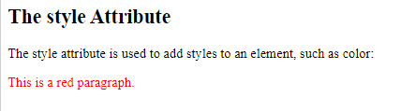
STYLE ATTRIBUTE

Slide 21
Links
HTML links are defined with the <a> tag
The link's destination is specified in the href attribute.
target attribute specifies where to open the linked document(_self,_blank,...)24
<a href="http://www.google.com" target="_blank">This is a link to Google!</a>
This is a link to Google!

Slide 22
HREF ATTRIBUTE
The href attribute specifies the URL of the page the link goes to:

Slide 23
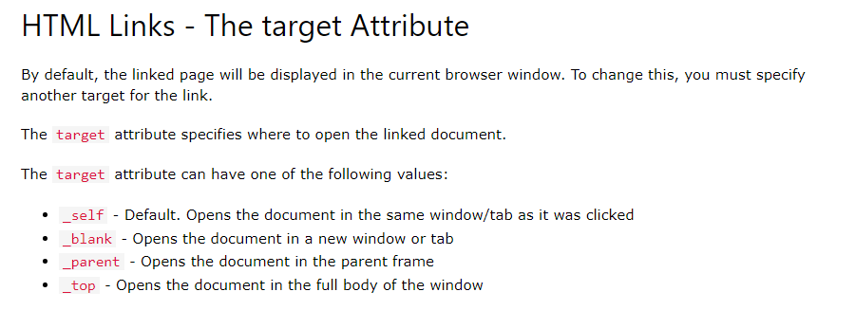
TARGET ATTRIBUTE

Slide 24

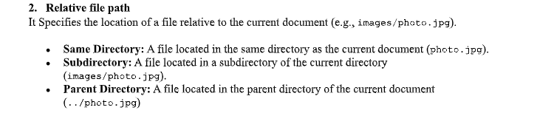
Relative vs. Absolute paths for links & Images

Slide 25
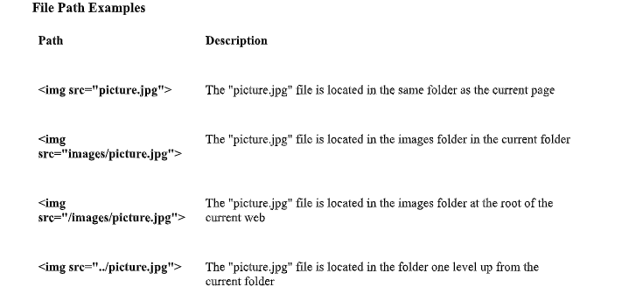

Slide 26
Relative vs. Absolute paths for links & Images
Relative paths change depending upon the page the link is on
Links within the same directory need no path information. "filename.jpg"
Subdirectories are listed like. "img/filename.jpg"
Absolute paths refer to a specific location of a file, including the domain
Typically used when pointing to a link that is not within your own domain.
http://one.fsu.edu/alumni/image/community/clubs/FSU-Seal-full-color.jpg

Slide 27
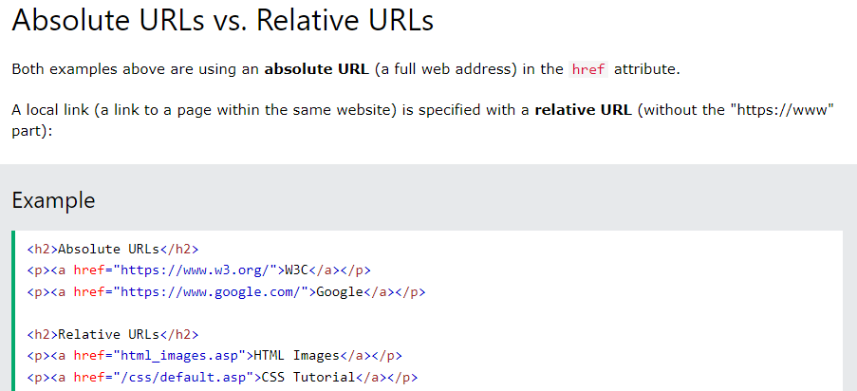
Relative vs. Absolute paths for links & Images

Slide 28

Images
HTML images are defined with the <img> tag.
The source file (src), alternative text (alt), width, and height are provided as attributes.
<img src="fsu-logo.jpg" alt="FSU Logo" width="104" height="142">

Slide 29
SRC Attribute
The src attribute specifies the path to the image to be displayed:
<img src=“xyz.jpg" alt=“abcdef" width="104" height="142">

Slide 30
WIDTH AND HEIGHT ATTRIBUTE
It specify the width and height of the image (in pixels):
<img src="img_girl.jpg" width="500" height="600">

Slide 31
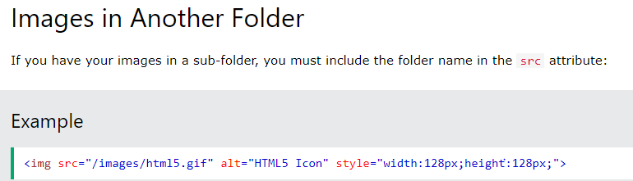
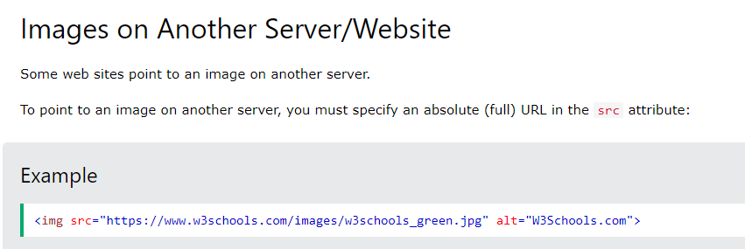

Slide 32

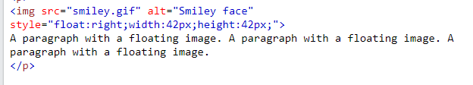
Use image as a link
Use image as a float

Slide 33
Headings
HTML headings are defined with the <h1> to <h6> tags.
<h1> defines the most important heading. <h6> defines the least important heading
<h1>This is heading 1</h1>
This is heading 1
This is heading 2
This is heading 3
This is heading 4
This is heading 5
This is heading 6

Slide 34
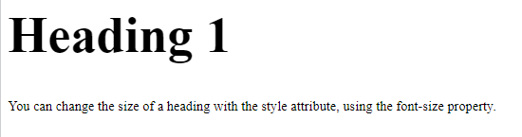
Bigger headings
Each HTML heading has a default size. However, you can specify the size for any heading with the style attribute, using the CSS font-size property:
Example
<h1 style="font-size:60px;">Heading 1</h1>

Slide 35
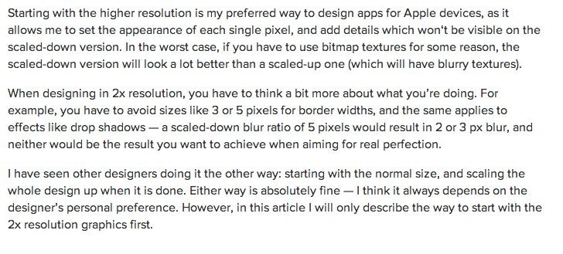
Paragraphs
HTML paragraphs are defined with the <p> tag:
<p>This is a paragraph</p> <p>Paragraph 2</p>

Slide 36
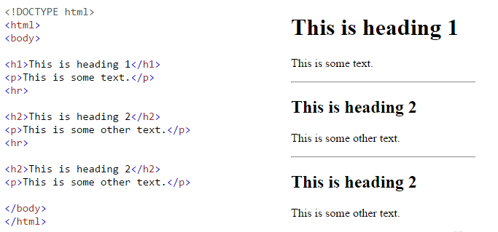
HTML Horizontal Rules
The <hr> tag defines a thematic break in an HTML page, and is most often displayed as a horizontal rule.
The <hr> element is used to separate content (or define a change) in an HTML page:

Slide 37
The Poem Problem and Line Breaks
This poem will display in a single line:
<p>
My Bonnie lies over the ocean. My Bonnie lies over the sea.
My Bonnie lies over the ocean. Oh, bring back my Bonnie to me.
</p>
The browser will remove any extra spaces and extra lines when the page is displayed
The <br> element defines a line break without starting a new paragraph.
<p>
My Bonnie lies over the ocean. <br> My Bonnie lies over the sea. <br> My Bonnie lies over the ocean. <br> Oh, bring back my Bonnie to me.
</p>

Slide 38
Preformatted Text
The HTML <pre> element defines preformatted text.
The text inside a <pre> element is displayed in a fixed-width font (usually Courier), and it preserves both spaces and line breaks.
<pre>
My Bonnie lies over the ocean. My Bonnie lies over the sea.
My Bonnie lies over the ocean. Oh, bring back my Bonnie to me.
</pre>
This will be shown correctly with line breaks preserved.

